Slide 1

Aqua Track

Slide 2

scope
The Aqua Track system is designed to promote sustainable water use and conservation in alignment with SDG 6 – Clean Water and Sanitation. It provides individuals, households, businesses, and local governments with real-time insights into water consumption through IoT-enabled monitoring devices.
The system will:
Monitor water usage using smart water flow sensors installed at consumption points.
Analyze daily, weekly, and monthly consumption patterns to identify wastage and inefficiencies.

Slide 3
Functional requirements
User Registration and Authentication Module
Secure sign-up and login (email/username + password, or SSO).0
Usage Limit Module
Display live water consumption data from IoT sensors.
Water Consumption Module
Generate detailed usage analytics and trends.

Slide 4
Non functional requirements
Performance
System must update water consumption data every 60 seconds.
Security
End-to-end encryption for data transfer.

Slide 5
SOFTWARE REQUIREMENTS
Frontend:
HTML5, CSS3, JavaScript (React or Vue.js)
Bootstrap/Tailwind for responsive UI
Backend:
Laravel (PHP)
MySQL / PostgreSQL for relational database

Slide 6
SOFTWARE REQUIREMENTS
Frontend:
HTML5, CSS3, JavaScript (React or Vue.js)
Bootstrap/Tailwind for responsive UI
Backend:
Laravel (PHP)
MySQL / PostgreSQL for relational database

Slide 7
HARDWARE REQUIREMENTS
For Users:
Smartphone (Android 10+ / iOS 14+) or PC (Windows 10+, macOS)
Internet connection (minimum 2 Mbps)
For Server:
CPU: Quad-core 3.0 GHz or higher
RAM: 16 GB
Storage: 500 GB SSD
Network: 1 Gbps connection

Slide 8
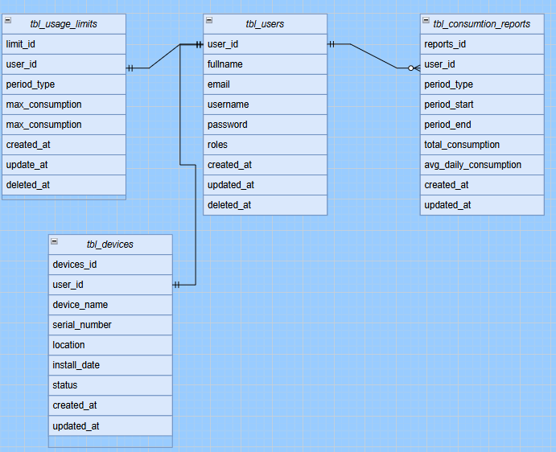
Database schema

